Slide 1
4.4 Itô-Doeblin Formula
報告人：劉彥君

Slide 2
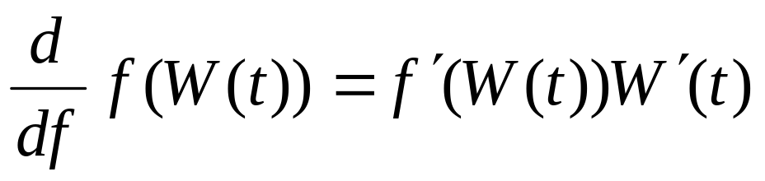
4.4.1 Formula for Brownian motion
We want a rule to “differentiate” expressions of the form f(W(t)), where f(x) is a differentiable function and W(t) is a Brownian motion. If W(t) were also differentiable, than the chain rule from ordinary calculus would give

Slide 3
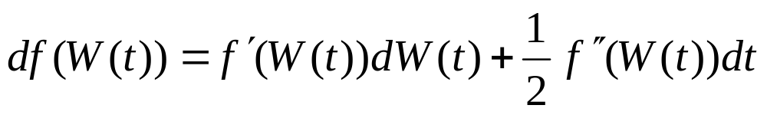
Which could be written in differential notation as
Because W has nonzero quadratic variation, the correct formula has an extra term,
(4.4.1)
This is the Itô-Doeblin Formula in differential form.

Slide 4
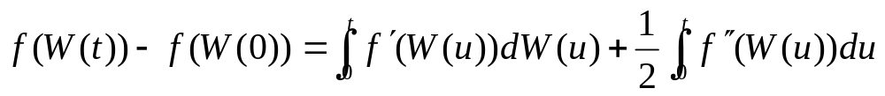


Integrating this, we obtain the Itô-Doeblin Formula in integral form
(4.4.2)
The mathematically meaningful form of the Itô-Doeblin Formula is the integral form.
This is because we have precise definitions for both terms appearing on the right-hand side.
  is an Itô integral, defined in section 4.3.
  is an ordinary (Lebesgue) integral with respect to the time variable.

Slide 5
For pencil and paper computations, the more convenient form of the Itô-Doeblin Formula is the differential form.
The intuitive meaning is that
  df(W(t)) is the change in f(W(t)) when t changes a “little bit” dt
  d(W(t)) is the change in the Brownian motion when t changes a “little bit” dt
  And the whole formula is exact only when the “little bit” is “infinitesimally small.” Because there is no precise definition for “little bit” and “infinitesimally small,” we rely on (4.4.2) to give precise meaning to (4.4.1).

Slide 6
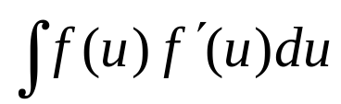
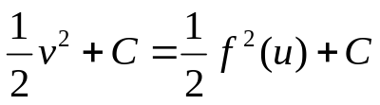
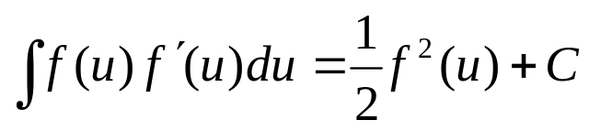
The relationship between (4.4.1) and (4.4.2) is similar to that developed in ordinary calculus to assist in changing variables in an integral.
Compute
Let v=f(u), and write dv=f’(u)du, so that the indefinite integral becomes ∫vdv, which is
where C is a constant of integration.
The final formula
is correct, as can be verified by differentiation.

Slide 7
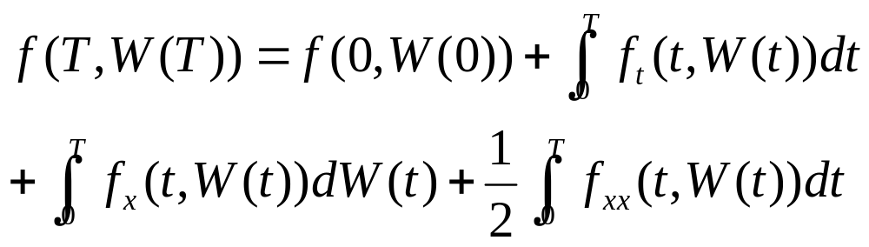
Theorem 4.4.1
(Itô-Doeblin formula for Brownian motion)
Let f(t,x) be a function for which the partial derivatives f_{t}(t,x), f_{x}(t,x), and f_{xx}(t,x) are defined and continuous, and let W(t) be a Brownian motion. Then, for every T>=0,

Slide 8
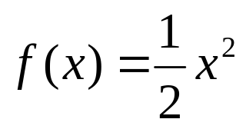

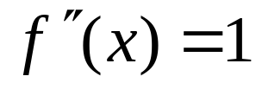
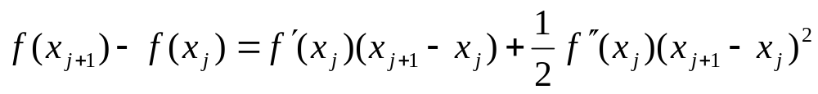
Theorem 4.4.1
(Itô-Doeblin formula for Brownian motion)
First we show why it holds when
In this case, and
Let x_{j+1}, x_{j} be numbers. Taylor’s formula implies
In this case, Taylor’s formula to second order is exact (there is no remainder term)
  Because f’’’ and all higher derivatives of f are zero.

Slide 9
Theorem 4.4.1
(Itô-Doeblin formula for Brownian motion)
Fix T>0, and let ∏={t₀, t₁, …, t_{n}} be a partition of [0, T] (i.e., 0=t₀<t₁<…<t_{n}=T).
We are interested in the difference between f(W(0)) and f(W(T)).
This change in f(W(t)) between times t=0 and t=T can be written as sum of the changes in f(W(t)) over each of the subintervals [t_{j},t_{j+1}].

Slide 10
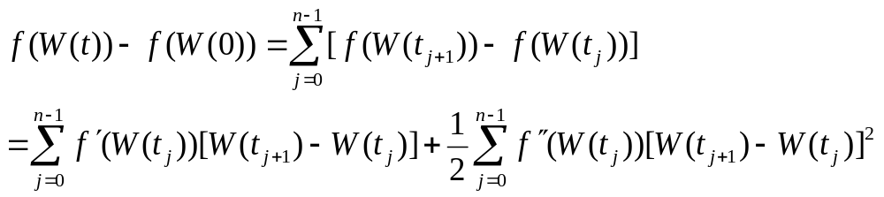
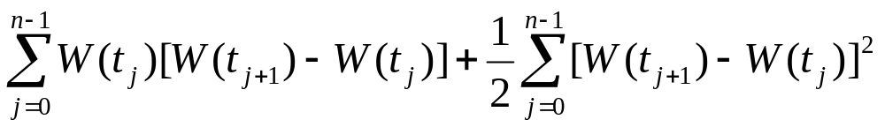
Theorem 4.4.1
(Itô-Doeblin formula for Brownian motion)
We do this and then use Taylor’s formula with x_{j}=W(t_{j}) and x_{j+1}=W(t_{j+1}) to obtain
(4.4.5)
For the function ,the right-hand side is
(4.4.6)

Slide 11
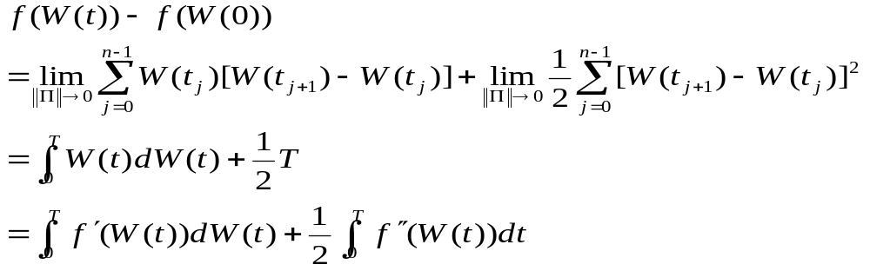
Theorem 4.4.1
(Itô-Doeblin formula for Brownian motion)
If we let ||∏||→0, the left-hand side of (4.4.5) is unaffected and the terms on the right-hand side converge to an Itô integral and one-half of the quadratic variation of Brownian motion, respectively:
(4.4.7)
This is the Itô-Doeblin formula in integral form for the function

Slide 12
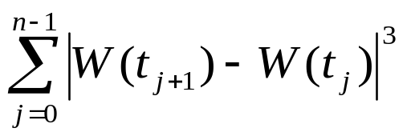
Theorem 4.4.1
(Itô-Doeblin formula for Brownian motion)
If we had a general function f(x), then in (4.4.5) we would have also gotten a sum of terms containing [W(t_{j+1})-W(t_{j})]³ .
But according to Exercise 3.4 Chapter 3 (pp118, (ii)) has limit zero as ||∏||→0
Therefore, this term would make no contribution to the final answer.

Slide 13
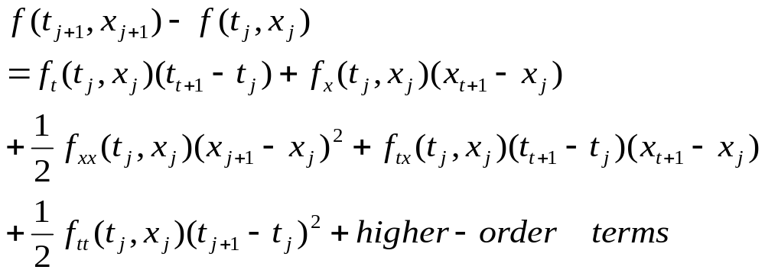
Theorem 4.4.1
(Itô-Doeblin formula for Brownian motion)
If we take a function f(t,x) of both the time variable t and the variable x, then Taylor’s Theorem says that

Slide 14
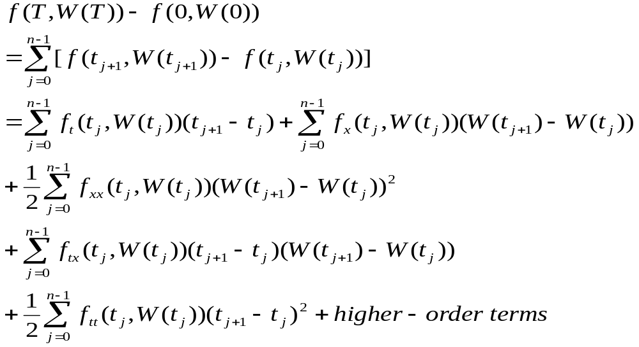
Theorem 4.4.1
(Itô-Doeblin formula for Brownian motion)
We replace x_{j} by W(t_{j}), replace x_{j+1} by W(t_{j+1}), and sum:
(4.4.9)

Slide 15
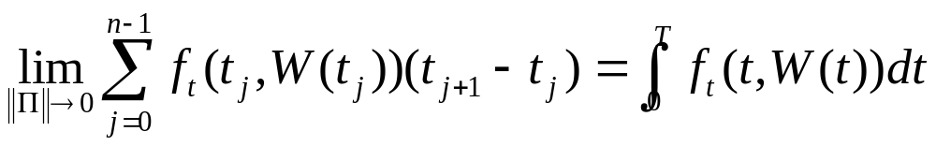
Theorem 4.4.1
(Itô-Doeblin formula for Brownian motion)
When we take the limit as ||∏||→0, the left-hand side of (4.4.9) is unaffected.
The first term on the right-hand side of (4.4.9) contributes the ordinary (Lebesgue) integral

Slide 16
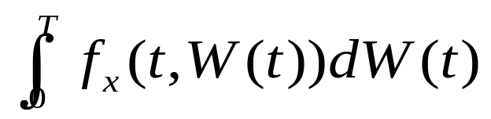
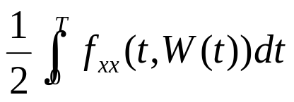
Theorem 4.4.1
(Itô-Doeblin formula for Brownian motion)
As ||∏||→0, the second term contributes the Itô integral
The third term contributes
  We can replace (W(t_{j+1})-W(t_{j}))² by t_{j+1}-t_{j}
  This is not an exact substitution, but when we sum the terms this substitution gives the correct limit as ||∏||→0.
  See Remark 3.4.4
These limits of the first three terms appear on the right-hand side of Theorem formula.

Slide 17
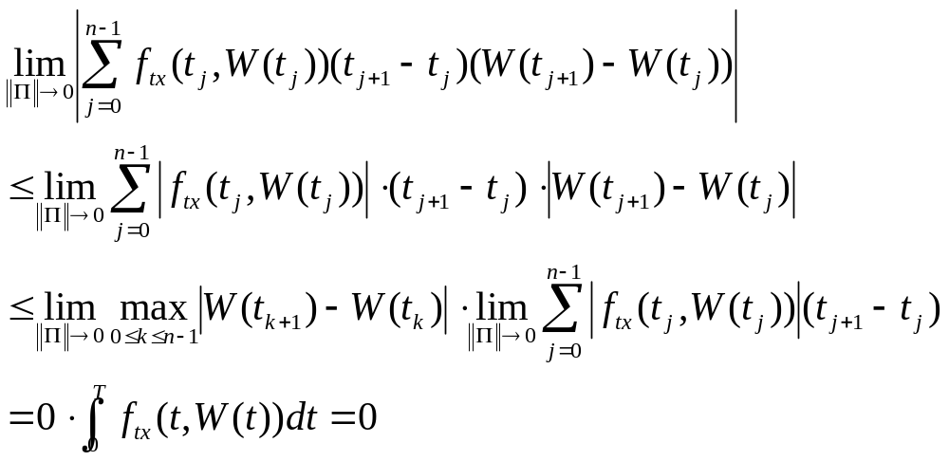
Theorem 4.4.1
(Itô-Doeblin formula for Brownian motion)
The fourth and fifth terms contribute zero.
For the fourth term, we observe that
(4.4.10)

Slide 18
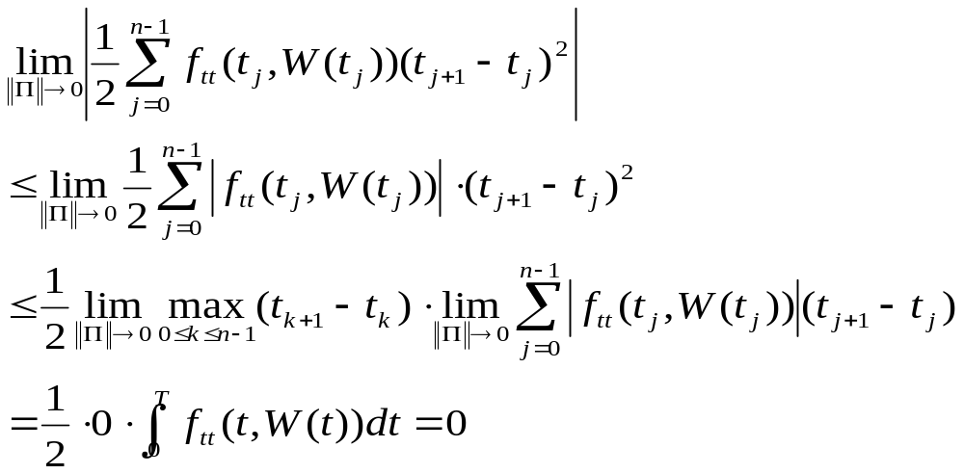
Theorem 4.4.1
(Itô-Doeblin formula for Brownian motion)
The fifth term is treated similarly:
(4.4.11)
The higher-order terms likewise contribute zero to the final answer.

Slide 19
Remark 4.4.2
The fact that the sum (4.4.10) of terms containing the product (t_{j+1}-t_{j})(W(t_{j+1})-W(t_{j})) has limit zero can be informally recorded by the formula dtdW(t)=0.
Similarly, the sum (4.4.11) of terms containing (t_{j+1}-t_{j})² also has limit zero, and this can be recorded by the formula dtdt=0.

Slide 20
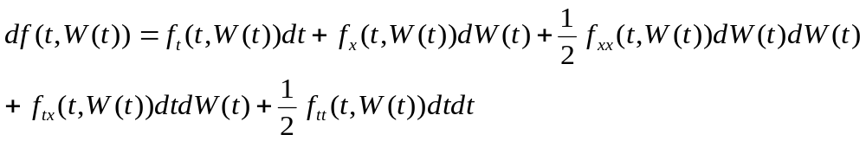
Remark 4.4.2
We can write these terms if we like in the Itô-Doeblin formula, so that in differential form it becomes
But
And the Itô-Doeblin formula in differential form simplifies to

Slide 21
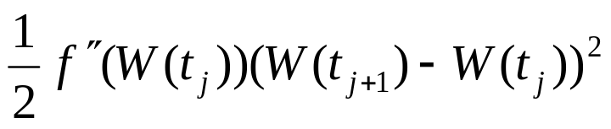
Remark 4.4.2
In Figure 4.4.1, the Taylor series approximation of the difference f(W(t_{j+1}))-f(W(t_{j})) for a function f(x) that does not depend on t.
The first-order approximation, which is f’(W(t_{j}))(W(t_{j+1})-W(t_{j})), has an error due to the convexity of the function f(x).
Most of this error is removed by adding in the second-order term
,which captures the curvature of the function f(x) at x=W(t_{j})

Slide 22
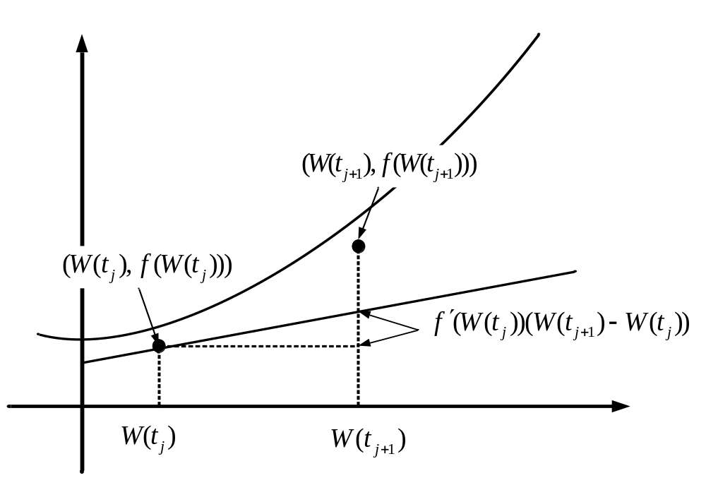
Fig. 4.4.1
Fig. 4.4.1 Taylor approximation to f(W(t_{j+1}))-f(W(t_{j}))

Slide 23
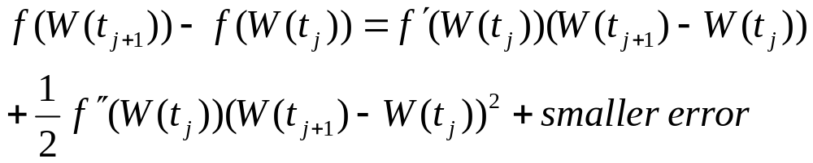
Remark 4.4.2
In other words,
(4.4.14)
And
(4.4.15)
In both (4.4.14) and (4.4.15), as ||∏||→0, the errors approach zero.

Slide 24
Remark 4.4.2
When we sum both sides of (4.4.14), the errors accumulate, and although the error in each summand approaches zero as ||∏||→0, the sum of the errors does not.
When we use the more accurate approximation (4.4.15), this does not happen; the limit of the sum of the smaller errors is zero.
We need the extra accuracy of (4.4.15) because the paths of Brownian motion are so volatile (i.e., they have nonzero quadratic variation).
This extra term makes stochastic calculus different from ordinary calculus.

Slide 25
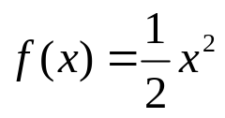
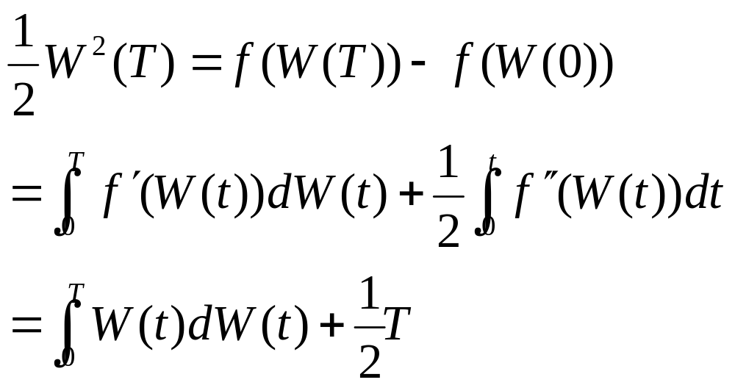
Remark 4.4.2
The Itô-Doeblin formula often simplifies the computation of Itô Integrals. For example, with this formula says that

Slide 26
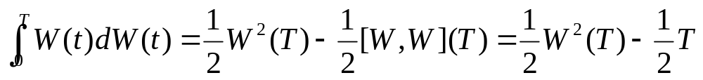
Rearranging terms, we have formula
(4.3.6)
and have obtained it without going through the approximation of the integrand by simple processes as we did in Example 4.3.2.

Slide 27
4.4.2 Formula for Itô Process
We extend the Itô-Doeblin formula to stochastic processes more general than Brownian motion.
The processes for which we develop stochastic calculus are the Itô processes defined below.
Almost all stochastic processes, except those that have jumps, are Itô process.

Slide 28
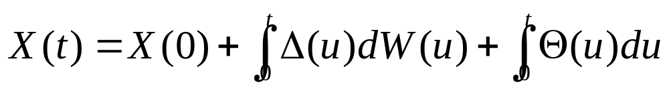
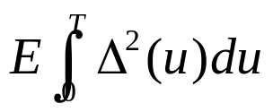
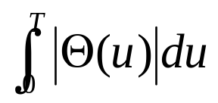
Definition 4.4.3
Let W(t), t≥0, be a Brownian motion, and let F(t), t≥0, be an associated filtration. An Itô process is a stochastic process of the form
(4.4.16)
Where X(0) is nonrandom and Δ(u) andΘ(u) are adapted stochastic processes.
We assume that and are finite for every t>0 so that the integrals on the right-hand side of (4.4.16) are defined and the Itô integral is a martingale.

Slide 29
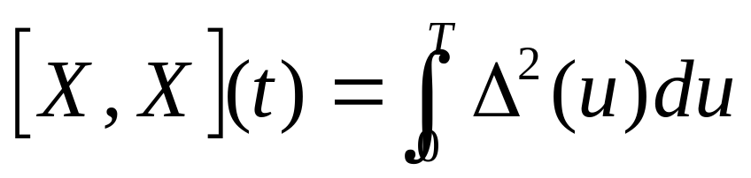
Lemma 4.4.4
The quadratic variation of the Itô process (4.4.16) is
(4.4.17)

Slide 30
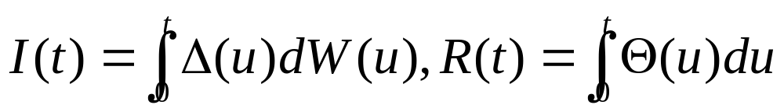
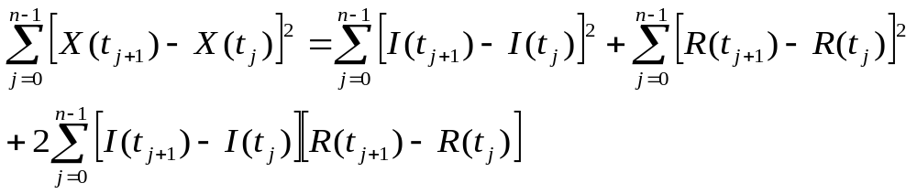
Lemma 4.4.4
We introduce the notation
Both these processes are continuous in their upper limit of integration t.
To determine the quadratic variation of X on [0,t], we choose a partition ∏={t₀,t₁,…,t_{n}} of [0,t] (i.e, 0=t₀<t₁<…<t_{n}=t) and we write the sampled quadratic variation

Slide 31
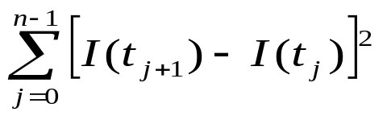
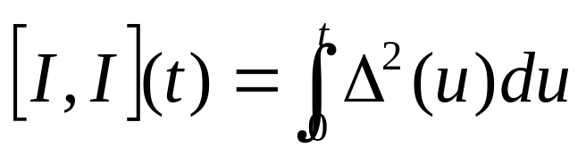
Lemma 4.4.4
As ||∏||→0, the first term on the right-hand side, converge to the quadratic variation of I on [0,t], which according to Theorem 4.3.1(vi) is

Slide 32
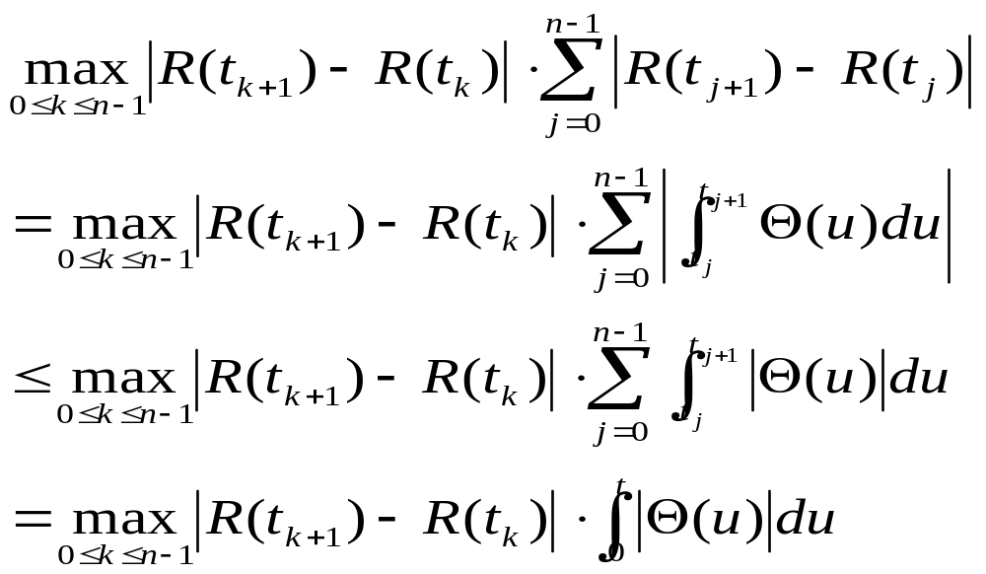
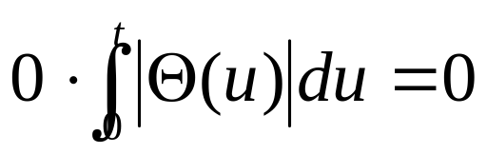
Lemma 4.4.4
The absolute value of the second term is bounded above by
As ||∏||→0, this has limit because R(t) is continuous.

Slide 33
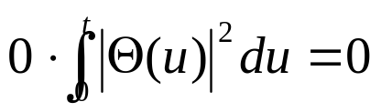
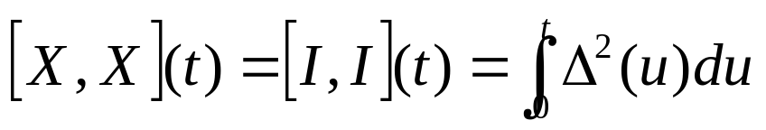
Lemma 4.4.4
The absolute value of third term is bounded above by
And this has limit as ||∏||→0 because I(t) is continuous.
We conclude that

Slide 34
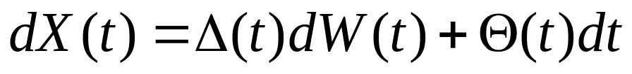
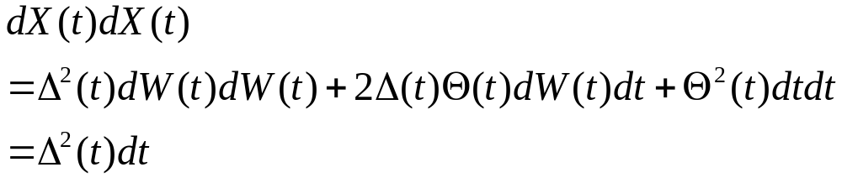
The conclusion of Lemma 4.4.4 is most easily remembered by first writing (4.4.16) in the differential notation
(4.4.18)
And then using the differential multiplication table to compute

Slide 35
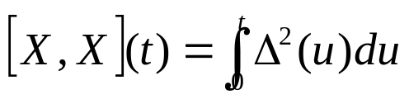
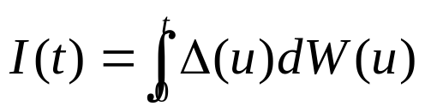
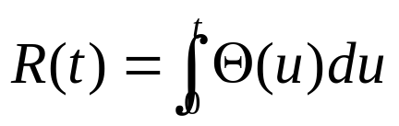
This says that, at each time t, the process X is accumulating quadratic variation at rate Δ²(t) per unit time, and hence the total quadratic variation accumulated on the time interval [0,t] is
This quadratic variation is solely due to the quadratic variation of the Itô integral
The ordinary integral has zero quadratic variation and thus contributes nothing to the quadratic variation of X.

Slide 36
Notice in this connection that having zero quadratic variation does not necessarily mean that R(t) is norandom.
Because Θ(u) can be random, R(t) can also be random, but R(t) is not as volatile as I(t).

Slide 37
At each time t, we have a good estimate of the next increment of R(t).
For small time steps h>0, R(t+h)≈R(t)+Θ(t)h, and we know both R(t) and Θ(t) at time t.
This is like investing in a money market account at a variable interest rate.
At each time, we have a good estimate of the return over the near future because we know today’s interest rate.
Nonetheless, the return is random because the interest rate (Θ in this analogy) can change.

Slide 38
At time t, on estimate of I(t+h) is
I(t+h)≈I(t)+Δ(t)(W(t+h)-W(t))
but we do not know W(t+h)-W(t) at time t.
In fact, W(t+h)-W(t) is independent of the information available at time t.
This is like investing in a stock.

Slide 39

So far we have discussed integrals with respect to time, such as appearing in (4.4.16) and Itô integrals (integrals with respect to Brownian motion) such as also appearing in (4.4.16).

Slide 40
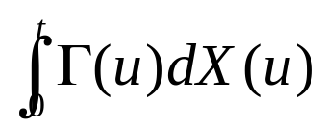
In addition, we shall need integrals with respect to Itô process (i.e., integrals of the form where Γ is some adapted process).
We define such an integral by separating dX(t) into a dW(t) term and a dt term as in (4.4.18).

